Slide 1
Do you have something NEW to add to a research topic you work on?
If you have appropriate data to tell a story ….
It’s time to write a manuscript!
If you are a student or postdoc, this initiative is usually agreed upon with your PI (the main name on the grants that fund your research) or your direct supervisor

Slide 2
Along with your co-authors, choose a suitable journal for your story
• Journal choice will depend mostly on the subject and type of data, and whether or not your story is hot enough to aim at a particular journal
• Follow the requirements on the journal’s website for your manuscript category for all subsequent writing steps
• Keep in mind and frequently go back to the target journal’s guidelines for content as well as formatting (font, tables, figures, footnotes, references) and usually the most difficult to comply with:
word count limit: particularly challenging to non-English native speakers (romance language speakers: Portuguese, Spanish, Italian, French)

Slide 3
Useful manuscript writing tips
• Use published papers in the same topic as examples of how to present specific parts of your story (figures, methods, results)
• When in doubt about how to refer to something in your field or whether a method has been published, use Google search/Pubmed
• Check and comply with requirements on the journal’s webpage as you write the different sections
• Refer to methods and results in PAST TENSE
• Use word auto correct- check whether journal is in the US or in the UK/Europe and set your word language to the right one (US or UK ENGLISH)

Slide 4
Useful manuscript writing tips
Avoid repeating things verbatim in different sections:
* from previous publications (in introduction and discussion sections)
* in the abstract (from other manuscript sections)
* in discussion (from results)
* in conclusions (from results and discussion)
Instead…. REPHRASE or SUMMARIZE or even better, add something to it such as connection to other factors, analysis, interpretation

Slide 5
Useful manuscript writing tips
Remember that you are writing for the READERS:
* scientific community in your field (and beyond)
* reviewers
So make it easy to read and to get the message: be clear, coherent and as brief as possible, present essential and important pieces and focus on these to “sell” your story, get feedback from others if possible on your drafts

Slide 6
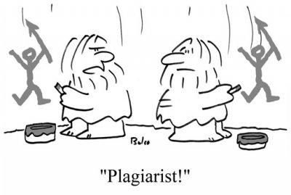
DON’T
Copy content from previous publications (even from your group)
From: http://blog.bio-lingo.com/blogs/index.php/plagiarism-what-is-ti-and

Slide 7
AVOID
Informal/colloquial writing and first-person pronouns (I, we) – use passive (some journals allow active)
From: https://aso-resources.une.edu.au/wp-content/uploads/2015/08Active_Passive_ voice-in-Scientific_Reports.png

Slide 8
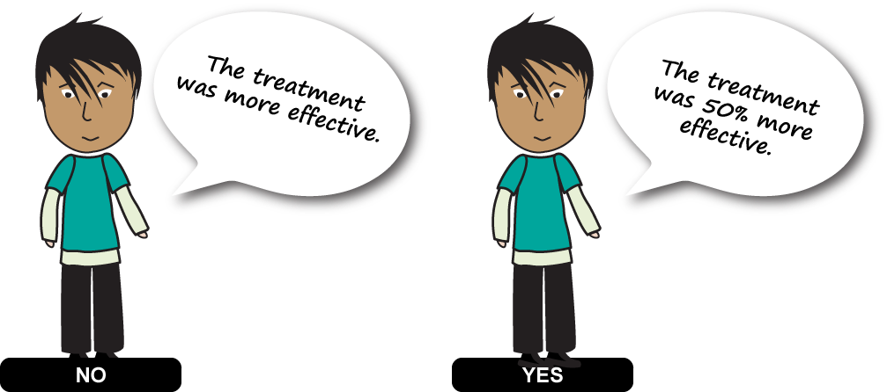
BE QUANTITATIVE
From: https://aso-resources.une.edu.au/wp-content/Uploads/2015/08/YES_NO_in-Scientific_Reports.png

Slide 9
DRAFTS
Throughout the writing process you may have several drafts
which will be used to REWRITE and MODIFY both structure and content to improve your manuscript. THIS IS GOOD.
The final draft should be as perfect as you can make it, do not
expect reviewers to edit it for you.
Throughout this process/drafts, the structure and content
of the manuscript may change based on how the story flows, missing or unnecessary bits may be identified
Writing process is different depending on what works for
you ….

Slide 10
Common research manuscript sections in most journals
(order)
TITLE (AUTHORS)
ABSTRACT
Keywords
INTRODUCTION
METHODS
RESULTS
DISCUSSION CONCLUSIONS
Acknowledgments
References

Slide 11
Common research manuscript sections in most journals
(manuscript order, writing order)
TITLE
ABSTRACT
Keywords
INTRODUCTION
METHODS
RESULTS (1) DISCUSSION
CONCLUSIONS
Acknowledgments
References

Slide 12
Common research manuscript sections in most journals
(manuscript order, writing order)
TITLE
ABSTRACT
Keywords
INTRODUCTION (3)
METHODS (2)
RESULTS (1) DISCUSSION (4… or 2) CONCLUSIONS (5)
Acknowledgments
References

Slide 13
Common research manuscript sections in most journals
(manuscript order, writing order)
TITLE (6)
ABSTRACT (6)
Keywords (6)
INTRODUCTION (3)
METHODS (2)
RESULTS (1) DISCUSSION (4) CONCLUSIONS (5)
Acknowledgments (6)
References (as you write, especially 2-3-4)

Slide 14
RESULTS
Make an outline of findings (include figures and tables)
• keep in mind that these may change in format and content as you write
• If possible, discuss your results with other researchers in your (or other) team(s) and with collaborators
• Depending on the journal (# Tables/Figs), choose main figures and which ones may go as supplementary, find a logical order/flow
• Focus on the most relevant data, eliminate those that are redundant or not relevant, or choose the most representative

Slide 15
RESULTS- TABLES and FIGURES
• Important data referred to in the results narrative are presented in Tables or Figures - choose the most appropriate, type of graph and size/resolution
• Can use figures/tables from posters or other previous presentation of your data
• Each figure stands by itself, no redundant figures (choose the best and most clear way to present your data)
• Titles and legends should be clear, brief and sufficient for the reader to understand the presented data (don’t repeat methods from that section)

Slide 16
RESULTS- TABLES and FIGURES
Supplementary/appendix: when not directly showing a result that addresses your hypothesis, or when a long Table that you would like to include for interested readers:
• genomics or transcriptomics (all omics): put the most relevant to your story in a main Table/Figure, then put the rest (complete list) as supplementary
• Long method (to reduce word count)
• Search strategy (review)

Slide 17
RESULTS - NARRATIVE
Write up the story corresponding to the Tables/Figs (data):
• The order and flow of the results should be coherent, and not necessarily in chronological order data were generated
• Include relevant “personal communication”, “data not shown” (or “unpublished observation” - these may go in discussion)
• This process may lead to identification of possible missing pieces (required further research prior to publishing) or alternatively it may show that the data could be split into two or more stories (reconsideration of target journals in this case)

Slide 18
Based on the results, write the METHODS section
• All methods used to generate the data in Tables and Figures
• Refer to published methods (indicating the reference in parenthesis) specifying modifications to what’s published
• Limit description to just methodology (technical) - avoid presentation of results or technical (methods) difficulties
• Statistical analysis goes after description of sites/measurements/experiments (often the last heading under methods)
• Try to present methods following results order

Slide 19
Based on the results, write the METHODS section
• An ethical statement should be included whenever the study used animals or humans, state clinical trial registration, etc
• Indicate source of reagents

Slide 20
Based on the results (and methods), write the INTRODUCTION/BACKGROUND section
• Touch on all background points relevant to your story that the reader needs to be familiar with
• Describe briefly previous studies relevant to your findings- more details on those that may be more relevant and/or very recent
• You are usually filling a knowledge gap, so emphasize what is known and what is not
• End with what your story is about, description of the need for it and aims – do not include results/findings

Slide 21
Based on the results, write the DISCUSSION
• Do not repeat findings/results in detail – mention briefly if needed when discussing
• Focus on how your findings agree or not (why? offer an explanation for studies showing different results- differences in methodology, population, season, etc) with previous studies related to the same subject as yours- include these references
• Emphasize how your study adds something new to the field/subject of study
• If recommendations can be made based on your findings (for policy if public health for example), they go here, as well as hypothesis or models based on your results

Slide 22
Based on the results, write the DISCUSSION
• If methodology used is new and of interest to the field, then discuss here
• Point out limitations of the study and caution on results interpretation
• Future research or next steps can be discussed

Slide 23
Based on results and discussion, write the CONCLUSIONS
• Do not repeat findings/results/discussion
• Clearly and concisely state what can be concluded from your data based on the aims and purpose of the study (aims mentioned at the end of the introduction, in the abstract and touched upon in discussion)
• How your work made a contribution, what can be derived from it, and what is needed next in terms of knowledge gaps still remaining

Slide 24
Based on all sections, write the ABSTRACT
• Do not copy/paste from other sections!
• Do not include references or uncommon abbreviations
• Keep in mind that abstract (and title) are usually what most people will read before deciding whether the paper is interesting
• Emphasize the purpose of the paper (question addressed), main findings and interpretation/conclusions- most journals have structured abstracts for research manuscripts: objective/background/aims; methods; results/findings/interpretation/discussions; conclusions
• WORD LIMIT: 100-250 words

Slide 25
The TITLE
• Be specific, brief, describe main point of the study using keywords and no abbreviations or acronyms
• Indicate location of study if patients included
AUTHORS: names and affiliations- usually agreed upon before the writing process starts, order is important, specific contributions (with author’s initials) are usually itemized in a statement included under “declarations”, which should also indicate that all authors approved the final manuscript and any conflict of interest.

Slide 26
ACKNOWLEDGMENTS
• Funding source- grants (agency, grant #, fellowships to individuals)
• If volunteers were included, thank them
• Contributors to the manuscript that are not authors: provided reagents, useful discussions, suggestions, critical reading and interpretation; reviewers may be thanked if suggestions helped improve the manuscript/story

Slide 27
REFERENCES
• Comply with journal’s required format and limit for references
• ENDNOTE and other software for entering refs and creating a library have options where you can choose refs formatting according to of journal (expensive but worth it- can get a package for your research group)

Slide 28
COMMON MISTAKES BY NON-NATIVE ENGLISH SPEAKERS
Instead of | Use
Like (to compare) | As, such as
First person (I, we) | Passive (check journal - some allow active/first person)
Present tense | Past tense (methods, results)
Same words in consecutive sentences or same paragraph | Change (especially verbs)

Slide 29
COMMON MISTAKES BY NON-NATIVE ENGLISH SPEAKERS
Instead of | Use
Defining abbreviations at different points | Only define FIRST TIME mentioned; Be consistent with symbols, units, etc
Contractions (it’s, doesn’t, won’t, shouldn’t) | No contractions (it is, does not, will not, should not)
Regarding/In regards to …. | DELETE- go straight to results
“As shown by XXXX et al” | reference in parenthesis (#) after the findings from that paper are mentioned

Slide 30
COMMON MISTAKES BY NON-NATIVE ENGLISH SPEAKERS
Instead of | Use
“Table/Figure X shows ….” | DELETE- refer to the Table/Fig in parenthesis when mentioning those results
Using long sentences | Short sentences- periods instead of commas
Mentioning results in introduction | Don’t- for intro just the reason for the study and aims
Copy/paste from other sections in abstract | Re-write summarizing and emphasizing main points

Slide 31
TIPS FOR NON-NATIVE ENGLISH SPEAKERS
THE BEST: Get help from a native English speaker to edit your manuscript (preferably with a science background or even better, in your area)
The more your write AND read manuscripts and published papers, the better you will get at it – join a “journal club” class or start one on your own with interested classmates
WHILE YOUR WRITE: There are tools you can use (not ideal but somewhat helpful), for example ….

Slide 32
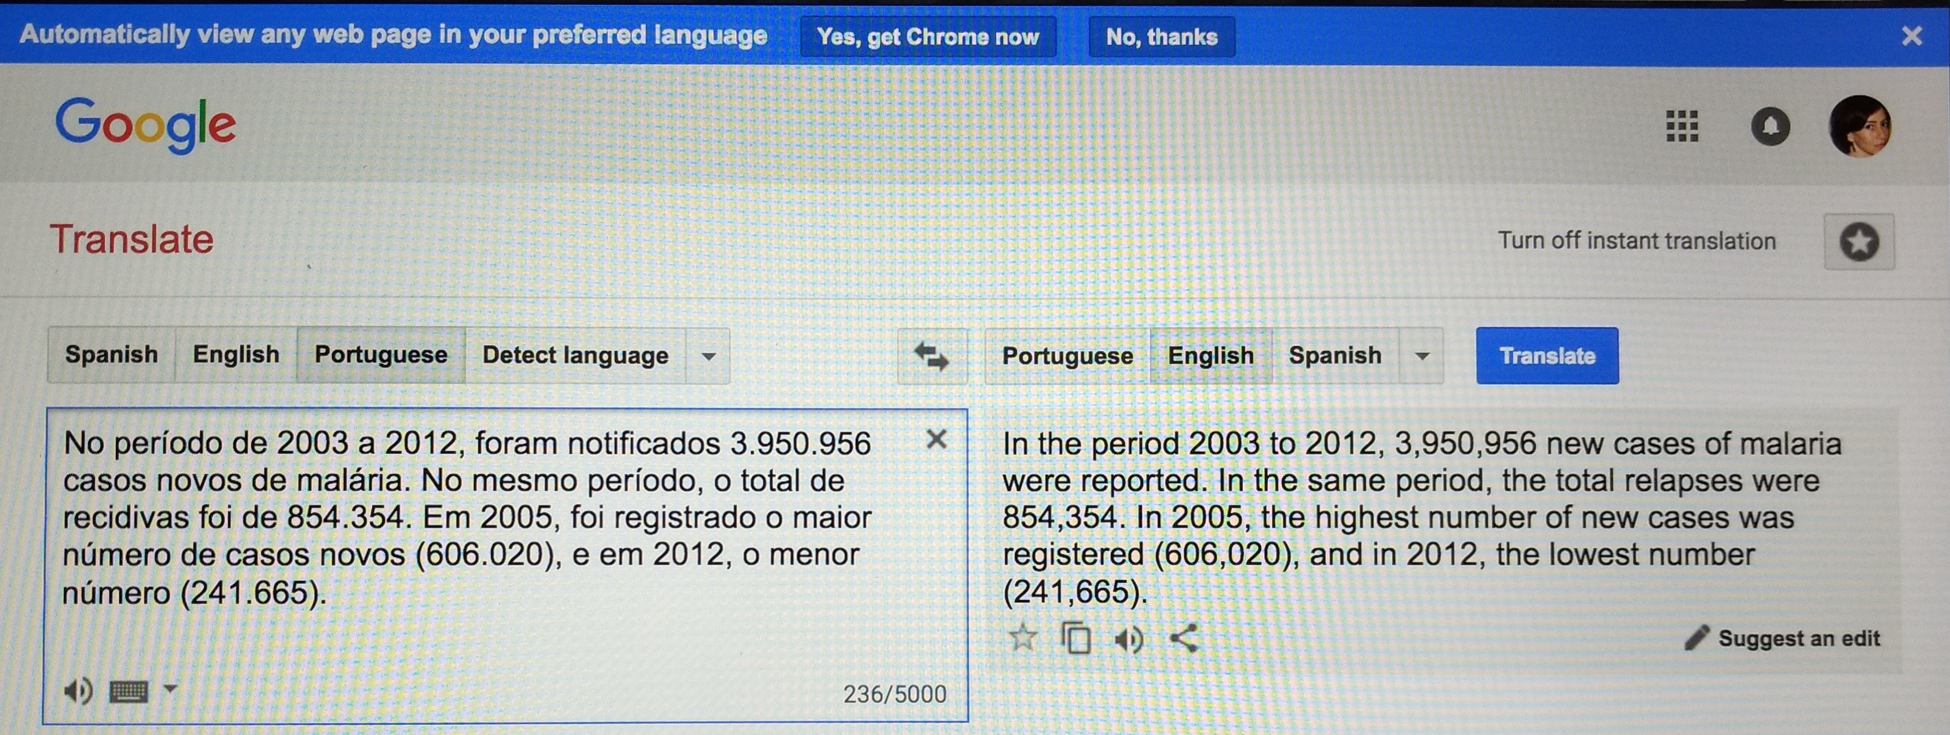
TIPS FOR NON-NATIVE ENGLISH SPEAKERS
USE GOOGLE TRANSLATE (far from perfect, but helpful)

Slide 33
TIPS FOR NON-NATIVE ENGLISH SPEAKERS
From GOOGLE TRANSLATE:
In the period 2003 to 2012, 3,950,956 new cases of malaria were reported. In the same period, the total relapses were 854,354. In 2005, the highest number of new cases was registered (606,020), and in 2012, the lowest number (241,665).
EDITED:
During the 2003-2012 period, 3,950,956 new cases of malaria were reported, with 854,354 total relapses. The highest and lowest incidence rates were registered in 2005 (606,020 new cases) and 2012 (241,665 new cases) respectively.

Slide 34
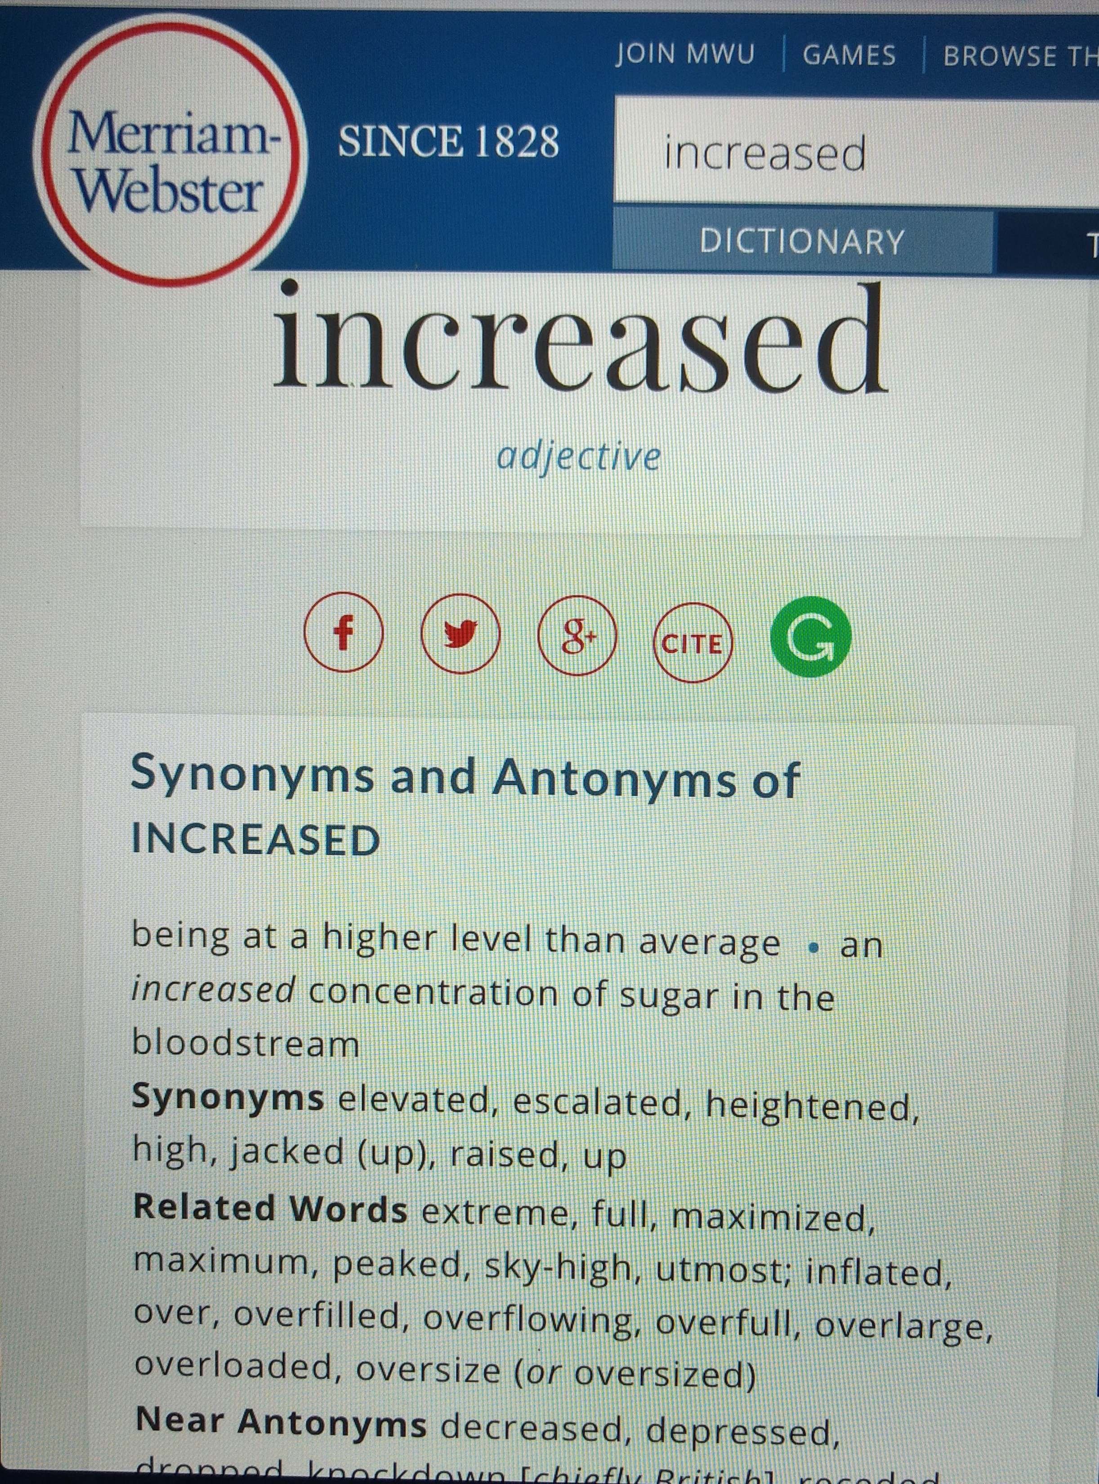
TIPS FOR NON-NATIVE ENGLISH SPEAKERS
USE THESAURUS (for
synonyms and antonyms)
Best site:
https://www.merriam-
webster.com/thesaurus

Slide 35
TIPS FOR NON-NATIVE ENGLISH SPEAKERS
use GOOGLE
To check whether what you think is right actually is- you can google a sentence/words and see if they have been used, including in papers in your research area

Slide 36
Useful websites on manuscript writing
https://www.elsevier.com/connect/11-steps-to-structuring-a-science-paper-editors-will-take-seriously (and https://www.elsevier.com/connect/six-things-to-do-before-writing-your-manuscript)
http://www.research4life.org/training/authorship-skills-2/ (download ppt file from Part B: how to write a scientific paper; and also possibly downloads from part D: strategies for effective writing)
http://www.icmje.org/recommendations/
for the Conduct, Reporting, Editing, and Publication of Scholarly work in Medical Journals, by the International Committee of Medical Journal Editors (downloadable or from the web)

